Slide 1

AI for
Performance Marketing
Nitan Jain
Chandigarh Growth Summit 2026
Notes:
Holding slide — leave this up while you are being introduced and while you walk on. Say nothing to it.

Slide 2


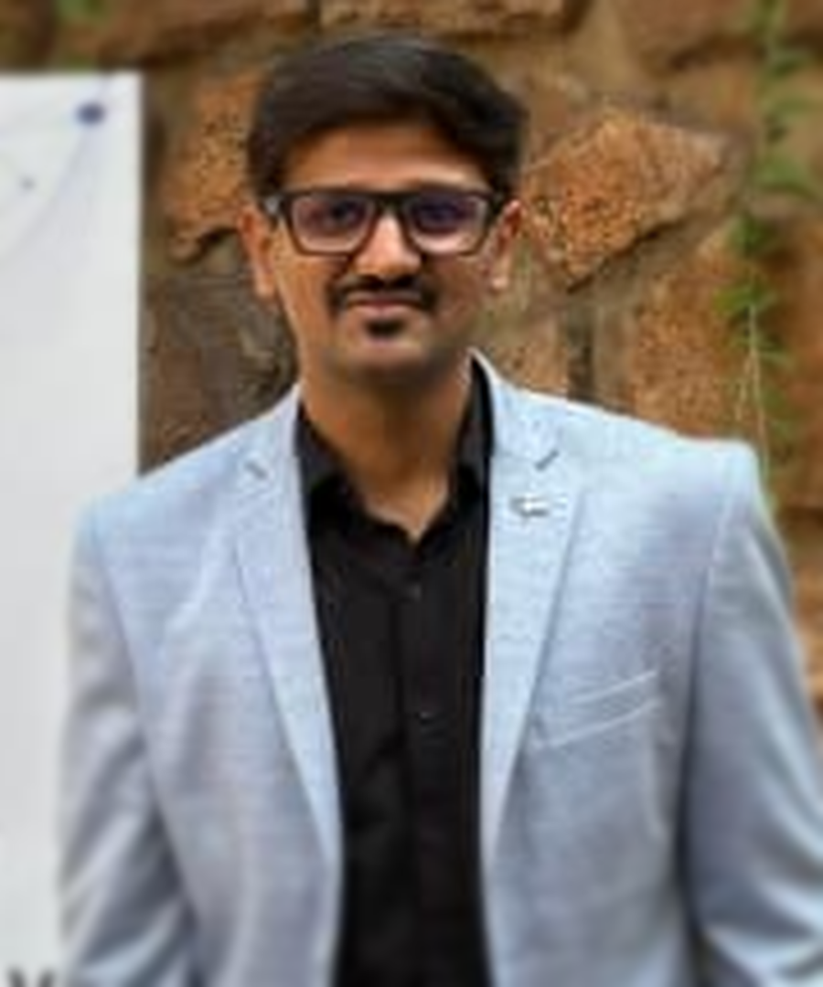
Nitan Jain
Co-founder, Vaizle · CEO, XOR Labs
12 yrs
300+
$Millions
buying media
since 2014
brands
managed
in ad spend
run by our team
Still in the accounts every week.
Notes:
~30 seconds. Say the roles, then ONE proof line — 'we have been buying media since 2014 and we still do it every day' — and move. Swap the brand names for logos and for whichever clients you are cleared to show. This slide buys you the room's attention for the next fourteen minutes; do not over-talk it.

Slide 3
EVERY MONDAY, EVERYWHERE
How’s the account doing?
9:02 AM
…somebody, by Thursday
The most-asked question in every company in this room.
Notes:
0:40–1:30 — The talk STARTS here. Hand off from your bio: ‘I am going to talk about AI in a minute. First I want to show you one account.’ The typing dots are the joke — the reply that never comes. Let the room find it.

Slide 4
ASK META · LAST 30 DAYS
Ask Meta:
8.61x
−10%
−15%
ROAS
Spend
Cost per purchase
up 13.94%
vs last month
vs last month
Better returns, on less money.
Notes:
1:00–2:00 — Real account, ours. Read the numbers slowly and admire them honestly — this IS a good month.

Slide 5
Everything here says:
scale it.
So that’s what we would have done.
Notes:
2:00–2:30 — Say 'we', not 'you'. You're not testing the room, you're admitting something. That's what makes the next slide land instead of feeling like a gotcha.

Slide 6
ASK THE STORE · SAME 30 DAYS
Ask the store:
−38%
+72%
−3%
Checkout completions
Money refunded
Net sales
vs last month
and returned
vs last month
2,848 reached checkout. 282 made it through.
Notes:
2:30–3:30 — Let the room do the maths themselves. Then say it plainly: scaling this account would have poured money into a bucket with a hole in it.

Slide 7
Both are true.
Meta did its job — brilliantly.
It answers for the surface it can see. It has never seen
your checkout, your refunds, or your margin.
Notes:
3:30–4:15 — Meta-positive, said with conviction. The ad account was healthy. The BUSINESS was leaking. No platform can see past its own boundary — that is not a flaw, it is a boundary.

Slide 8
Our best month.
And the client was leaving.
Notes:
~45 sec. ⚠ REPLACE WITH YOUR REAL STORY — do not say this unless it happened. The dashed bar is the month that never came. Say the second line only after the room has looked at it.

Slide 9
We weren’t lying to them.
We just couldn’t see past Meta.
WHAT WE COULD SEE
WHAT WE COULDN’T
Meta
Store revenue
Refunds & RTO
Margin
The same story you just watched — from my side of it.
Notes:
~1.5 min. The heart of it, seconds after the red numbers. The dashed boxes are everything the report could not reach. Own it plainly, do not soften it.

Slide 10
So we started pulling in the rest.
Meta
2019
+ the store
then
+ the website
then
+ the competitors
then
We built it so that call never happened again.
Notes:
~1 min. Each bar is longer than the last — years of work, one source at a time. Swap the year on the first bar for the real one.

Slide 11
Those scripts became Vaizle.
spend-check.py
rto-sheet.xlsx
creative-log
competitor-scan
margin-calc
daily-alert.sh
leak-finder
report-gen
↓
Ask anything
↑
And then it needed a real test.
Notes:
~30 sec. First time you name the product, and it arrives as the end of a story. Eight scattered scripts collapsing into one input box — that IS the product thesis.

Slide 12
SAME QUESTION · SAME ACCOUNT
So I asked two AIs
the same question.
✦
“Give me a state-of-my-account briefing for a founder.”
One is a world-class general AI. One is built for marketers.
Notes:
4:30–5:10 — Don't name the general AI. 'One of the big general models — you all use it.' Keep it respectful; it is genuinely good, and that makes the point stronger.

Slide 13
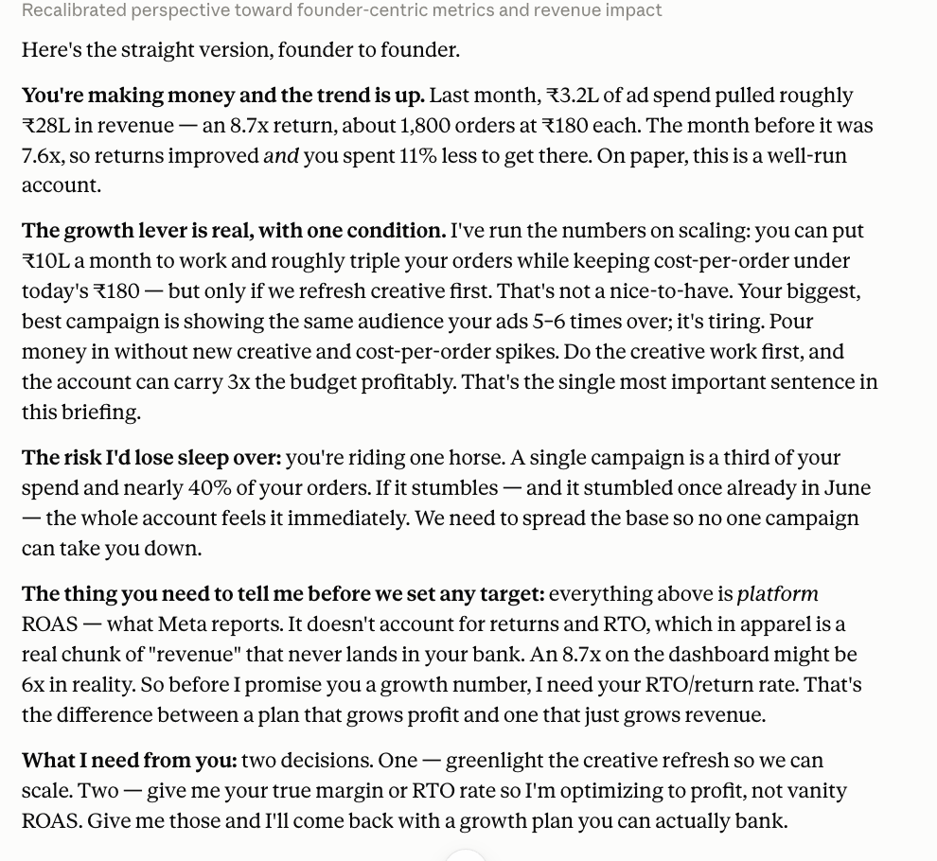
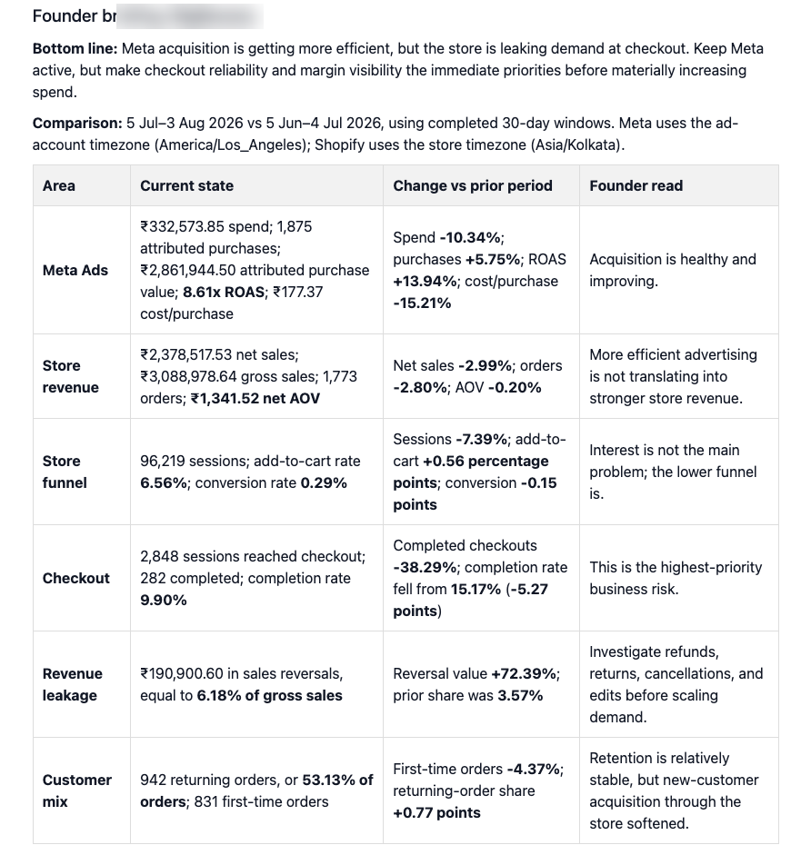
TWO ANSWERS · SAME DAY
THE GENERAL AI
VAIZLE
Notes:
5:20–6:00 — Show the evidence BEFORE the verdict. 'You cannot read this from row 20 — you do not need to. Look at the shape.' Left: paragraphs. Right: a table of your own store numbers. Then walk through what each could see.

Slide 14
WHAT EACH ONE COULD SEE
THE GENERAL AI
VAIZLE
Only what Meta
reported.
Meta — and the store
behind it.
“Your 8.7x might be 6x
in reality.”
It was guessing.
8.61x. And ₹1,90,900
already refunded.
It didn’t have to guess.
Same question. One had the numbers.
Notes:
Straight from the two screenshots. The general AI rounded to 8.7x and openly hedged — it told me my ROAS 'might be 6x in reality' and asked for my RTO rate. Vaizle had 8.61x to two decimals AND the ₹1,90,900 of reversals sitting against it. Spare ammunition if you want it: Meta counted 1,875 purchases; the store recorded 1,773 orders.

Slide 15
HOW EACH ONE ENDED
THE GENERAL AI
VAIZLE
“Tell me your margin
and return rate.”
“Refunds are up 72%.
Fix your checkout today.”
It needed more information.
It already knew.
Notes:
5:10–6:20 — The heart of the talk. The general AI even flagged RTO — it KNEW what was missing. It just couldn't see it. Pause before advancing.

Slide 16
WHAT EACH ONE TOLD ME TO DO
THE GENERAL AI
VAIZLE
“Refresh the creative,
then put ₹10 lakh
a month to work.”
“Do not scale yet.
Fix checkout today.
Hold Meta where it is.”
One of them would have scaled the leak.
Notes:
6:50–7:40 — The most expensive slide in the deck. Both answers are competent. Follow the left one and you put ₹10 lakh a month into an account whose checkout is broken. Say the bottom line slowly.

Slide 17
Neither one was wrong.
Only one was useful.
Notes:
Say it, stop, count to three. Be fair to the general AI here — it was articulate, it caught the RTO risk on its own, it just could not see. That fairness is what makes the next slide land.

Slide 18
WHY THE DIFFERENCE
Not a smarter model.
More context.
An answer is only as good as what stands behind it.
Notes:
7:10–7:50 — Both had the same class of intelligence. One had four layers of context the other structurally cannot get.

Slide 19
FOUR LAYERS
01
Your live account
Ads, social, web — together
02
Your backend
Store, sheets, refunds, margin
03
Your brand
Site, catalogue, audience
04
Your competitors
What changed outside your account
Notes:
7:50–9:20 — Spend most time on 02: 'This is the one no general AI can ever have. Your refunds live in your store, not on Meta.' 04 lands with the D2C crowd.

Slide 20
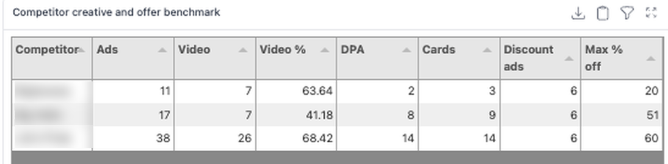
LAYER 04, IN PRACTICE
You run 11 ads.
They run 38.
Best offer
“Your gap isn’t your
brand. It’s your offer.”
You 20% off
Them 60% off
Not a metric. A conclusion.
Notes:
Live competitor read from Meta Ad Library, one week. It counted their ads, their video mix, their discount depth, and told us the gap was offer breadth — not positioning. No dashboard anywhere gives you that sentence.

Slide 21
THEN IT READ THE ADS
Then it read them.
“Patla nahi dikhna hai,
mujhe khush dikhna hai.”
Your most distinctive line. It said: build on this.
One coupon in 7 of 11 ads. It said: that’s your risk.
It didn’t count your ads. It understood them.
Notes:
Read the Hinglish line out loud — it lands. This is your own ad copy, and the tool called it your most emotionally distinctive, confidence-led voice versus generic sale copy. Then the flip side: consistency or promotional narrowness? Meanwhile competitors were running exchange offers, WhatsApp CTAs and store-led deals. No dashboard on earth reads Hinglish creative and forms a view about it.

Slide 22
IT ASKS YOU BACK
We didn’t ask for this one.
AFTER THE BRIEFING, IT FOLLOWED UP — UNPROMPTED
It saw the leak — and offered to watch the account for you.
Checkout. Reversals. Margin. Scaling alerts. Weekly, without being asked twice.
Notes:
~1 min. Real, unedited product moment — after the founder briefing, IT suggested the weekly dashboard with alerts. Read the quote off the screen slowly. This replaces the invented 9:14 AM alert with something that actually happened, which the room can feel.

Slide 23
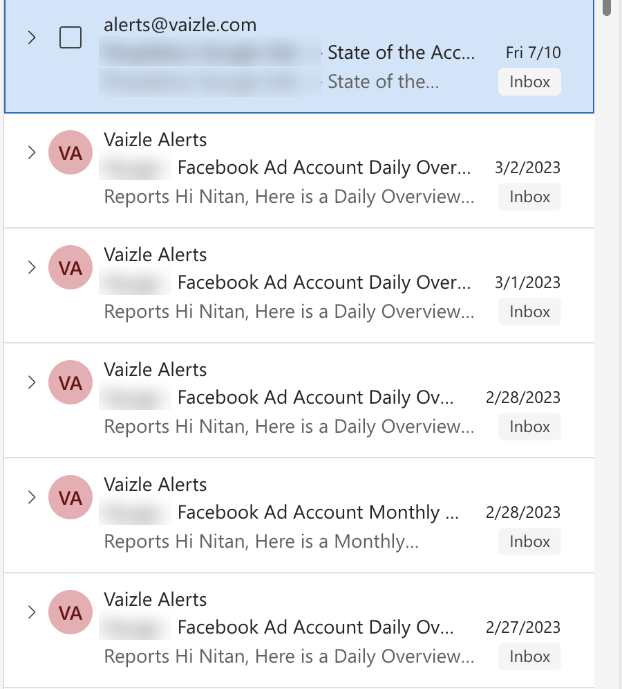
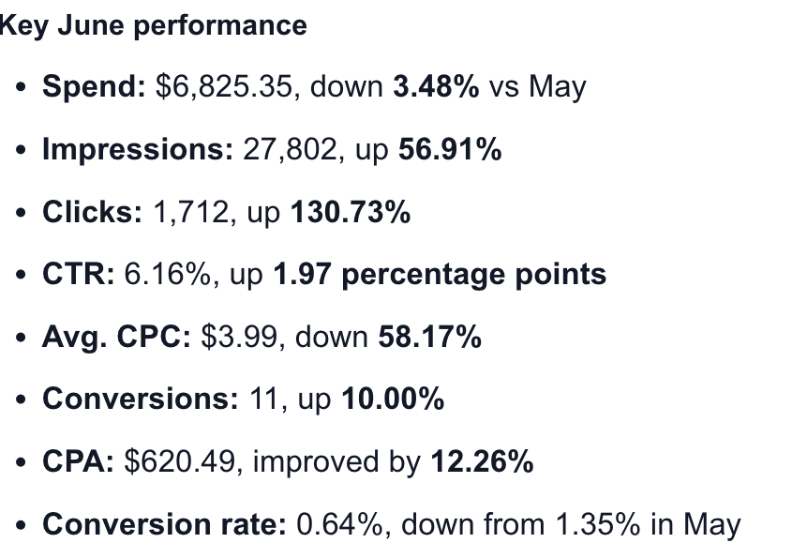
SCHEDULED
You don’t even have to open it.
Daily.
Weekly.
Monthly.
Or the moment
something breaks.
Set it once. It reports to you.
Notes:
~45 sec. Real inbox, real scheduled briefings from alerts@vaizle.com — client names blurred. Point out the dates: this has been running for years, not a demo. Pairs with the previous slide: it offered to watch, and this is what watching looks like.

Slide 24
Everyone has AI.
Almost nobody has context.
Context is the last thing that’s still yours.
Notes:
11:20–12:00 — The thesis, stated once at the end rather than promised at the start. Then: 'Let me show you it running live.'

Slide 25
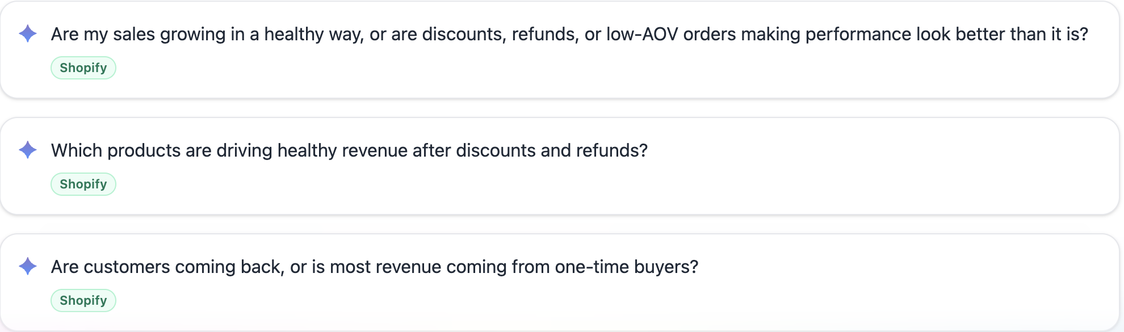
HOW YOU ASK IT
You don’t need to know what to ask.
Straight from the product — questions written by marketers, waiting in every account.
Notes:
12:10–13:40 — These cards are the live product, unedited (note the Shopify tags — store-aware questions). Launch the demo from here: pick the first card on screen and run it.

Slide 26
Everyone got a specialist.
DEVELOPERS
META
MARKETERS
An AI that knows
their code.
An AI that runs
your ads.
An AI that knows
your business.
That’s all this is.
Notes:
13:30–14:15 — The only time this frame appears. By now the room has SEEN the difference, so the slide states a conclusion instead of setting one up. Do not explain it — say only the last line, and say it small. Underselling here is what stops the ending sounding like an ad.

Slide 27
One question to take home.
So — how’s the account doing?
↑
You should know the answer before you scale. Not after.
Notes:
14:15–15:00 — The opening question handed back — now sitting in an input bar, ready to send. Last words of the talk. No product name, no ask.

Slide 28
Q&A
Ask me anything.
Notes:
15:00–25:00 — Ten minutes, clean screen, no offer on it. Mention the trial and the stall in your own words at the end of the Q&A instead.

